Slide 1
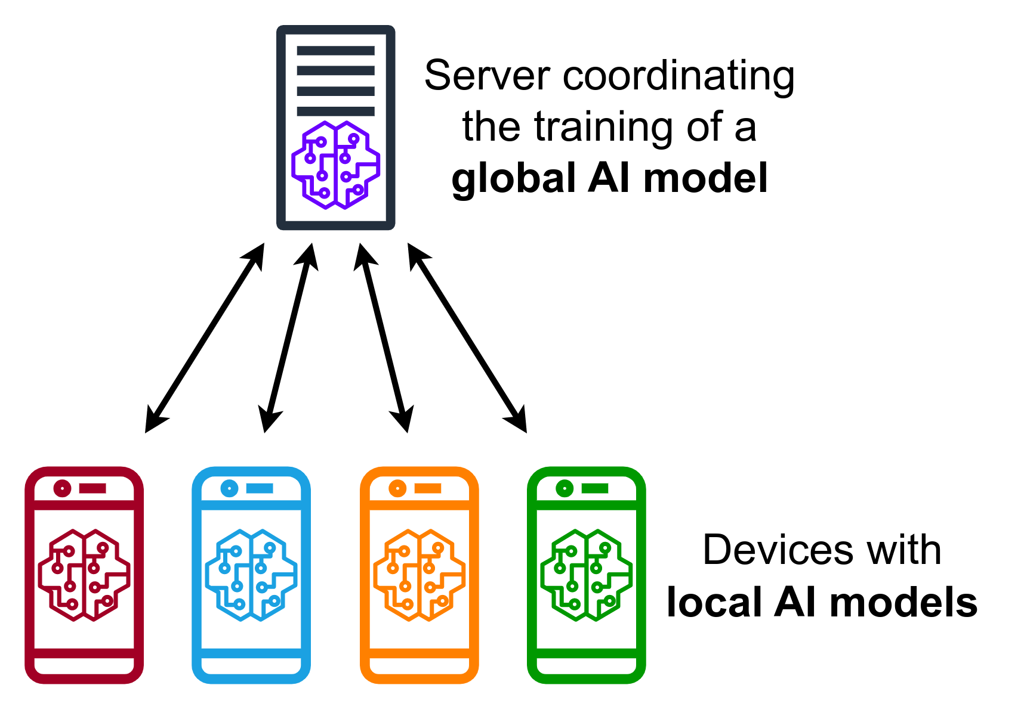
Federated Machine learning
GROUP 1: Hemang Mishra (21csu131)
` Kunal Jangid ( 21csu152)

Slide 2
Motivation
In today's interconnected world, data privacy and security are paramount concerns. Traditional machine learning approaches often require centralizing data for model training, which can raise privacy issues, especially when dealing with sensitive user data. Federated Learning addresses this challenge by enabling collaborative model training across decentralized devices while keeping data localized.
*Key Points:
1 .Privacy Preservation: Federated Learning allows training models on data without centralizing it, preserving user privacy.
2. Data Sovereignty: Users retain control over their data, fostering trust and compliance with regulations.
3. Scalability: Federated Learning enables scalable model training on large, diverse datasets distributed across devices.

Slide 3
Background
Federated Machine Learning extends traditional machine learning paradigms to accommodate distributed data settings, such as edge devices, IoT sensors, and mobile devices. It operates under the premise that data remains on user devices, and only model updates are shared and aggregated centrally. This approach introduces challenges like communication efficiency, model aggregation, and privacy preservation, which are addressed through various techniques and algorithms.
*Key Points:
1 .Decentralized Learning: Training models across distributed devices without centralizing data.
2. Model Aggregation: Techniques for aggregating model updates while preserving privacy and accuracy.
3. Communication Efficiency: Minimizing communication overhead between devices and the central server.

Slide 4
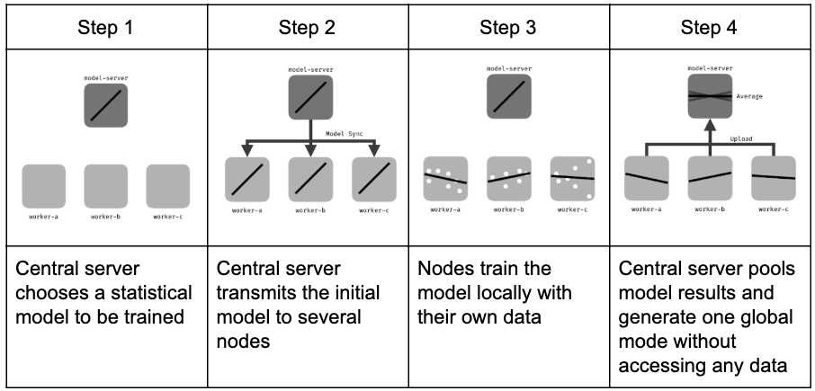
Steps of federated machine learning

Slide 5
Technical Limitations
Federated learning raises several statistical challenges:
Heterogeneity between the different local datasets: each node may have some bias with respect to the general population, and the size of the datasets may vary significantly;
Temporal heterogeneity: each local dataset's distribution may vary with time;
Interoperability of each node's dataset is a prerequisite;
Each node's dataset may require regular curations;
Hiding training data might allow attackers to inject backdoors into the global model;

Slide 6
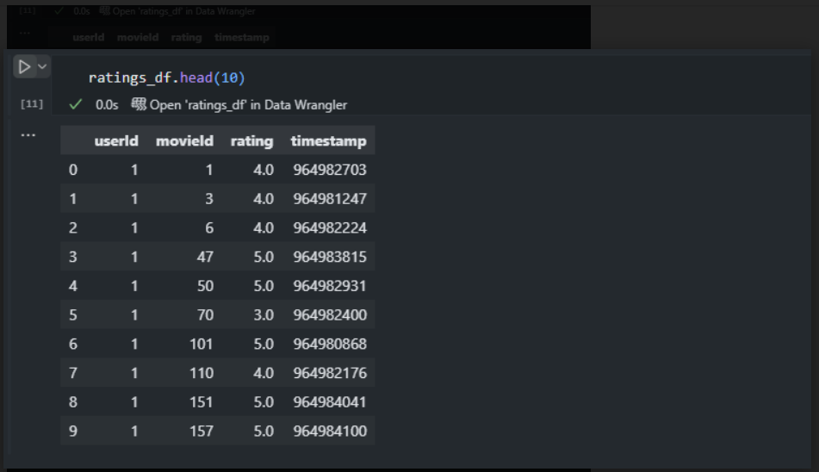
Dataset and Initiatlizing

Slide 7
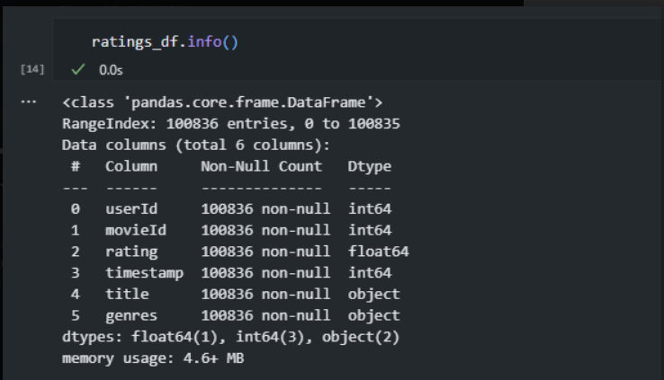

Slide 8
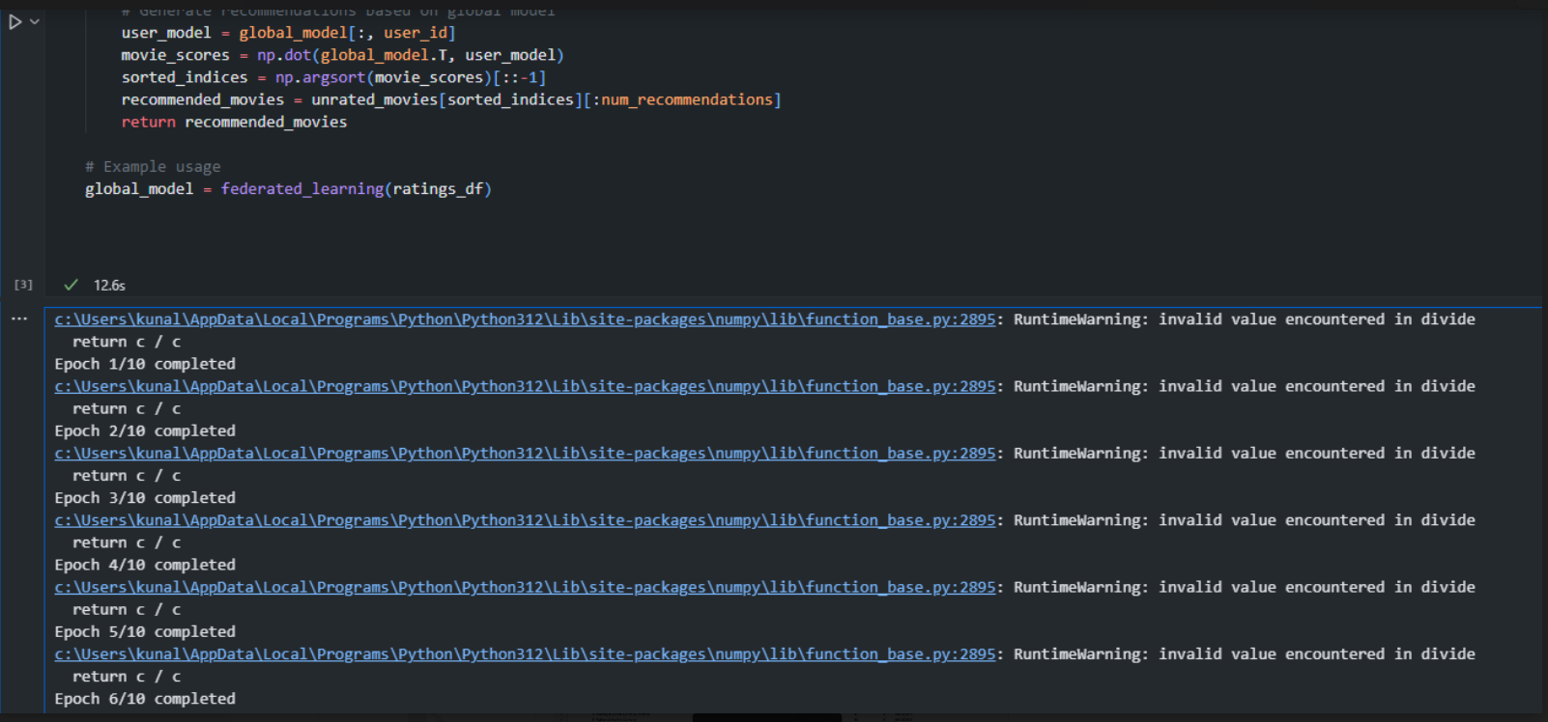

Slide 9
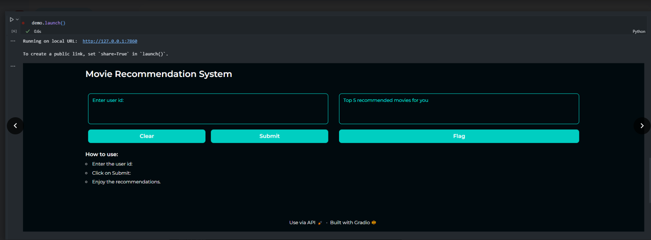

Slide 10
Framework of the Code and the Project
Our project implements federated learning for user-based collaborative filtering in recommendation systems. The framework consists of several components:
1.Data Loading: Loading and preprocessing the dataset containing user ratings.
2.Model Training: Implementing user-based collaborative filtering for generating recommendations.
3.Federated Learning: Simulating federated learning by training user models locally and aggregating them centrally.
4.Evaluation: Assessing the performance of the recommendation system using appropriate metrics.

Slide 11
Framework
Key Points:
1. Metric Selection: Choosing appropriate evaluation metrics based on the characteristics of the recommendation task.
2 .Benchmarking: Comparing the performance of our recommendation system against baseline models or industry standards.
3. Interpretation: Understanding the implications of evaluation metrics in the context of user satisfaction and system effectiveness.

Slide 12
Advantage of our code over conventional Models
Overall, completing multiple epochs in federated learning offers several benefits, including improved model performance, robustness to data heterogeneity, mitigation of communication overhead, enhanced privacy preservation, and adaptation to dynamic environments. These advantages make it a preferred approach for training machine learning models in decentralized settings with distributed data sources.

Slide 13
RESULTS
The results slide presents the outcomes of our federated learning-based recommendation system. This includes:
1.Performance Metrics: Displaying the evaluation results, such as precision, recall, and RMSE.
2.Comparison: Contrasting the performance of our system with baseline models or prior approaches.
3.Insights: Drawing insights from the results to understand the effectiveness and limitations of our recommendation system.

Slide 14
RESULTS
Key Points:
1. Performance Summary: Summarizing the performance of the recommendation system based on evaluation metrics.
2. Implications: Discussing the implications of the results on user experience, system scalability, and privacy preservation.
3. Future Directions: Identifying areas for improvement and potential avenues for future research and development.

Slide 15
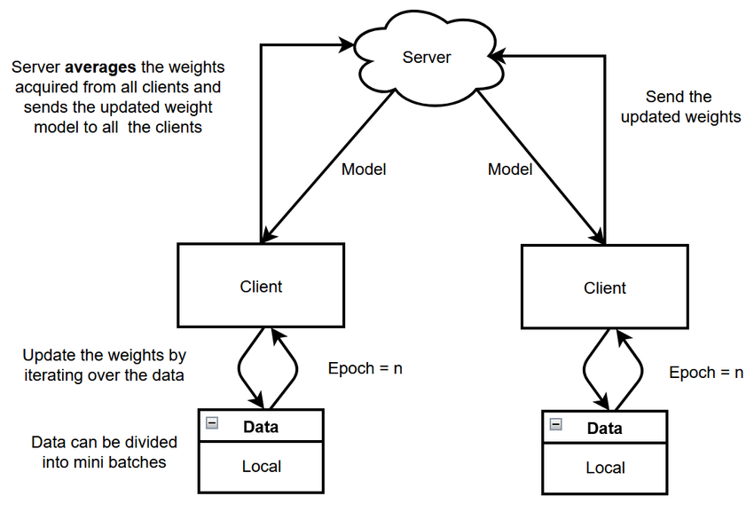
THANK YOU!

